Slide 1
Character Stereotypes
Victoria Küntz, Marco Quiroz, Charles Kenney

Slide 2
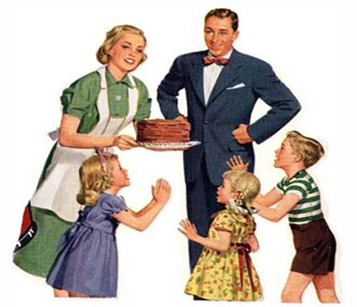
Pa
Examples of stereotypical behavior:
“Even Pa, who was the leader, would hold a wrench and take orders from Al.” (97)
“‘I ain’t no good any more. Spen’ all my time a-thinkin’ how it use’ ta be.’” (422)
“‘Funny! Woman takin’ over the fambly. Woman saying we’ll do this here, an’ we’ll go there. An’ I don’ even care.”
Purpose of Including Pa:
In The Grapes of Wrath, Pa is characterized as the stereotypical father and the leader of the family. In the beginning of the book, Pa had total authority of the family and led them through the preparation and execution of their journey to California. As the book goes on and the Family makes it to California, Pa finds it hard to adjust to their new way of life. Pa’s inability to find work causes him to retreat into his memories of “‘...how it use’ ta be,’” (422) and leads him to progressively cede his role as leader of the family to Ma. Steinbeck entered Pa into “the game”in The Grapes of Wrath to give an example of how hardships can completely break down a person. He is trying to prove the point that hardships do not always strengthen a character, while at the same time showing how much roles can change under harsh circumstances.

Slide 3
Ma
Examples of stereotypical behavior:
“She seemed to know that if she swayed the family shook, and if she ever really deeply wavered or despaired the family would fall, the family will to function would be gone” (74)
“‘All we got is the family unbroke. Like a bunch of cows, when the lobos are ranging, stick all together. I aint scared while we’re all here, all thats alive, but i ain’t gonna see us bust up.’”(168)
“‘families fallin’ apart’ she said. ‘I don’ know. Seems like i can’t think no more. I jus’ can’t think.’” (216)
Purpose of Including Ma:
Ma is revealed as a stereotypical character in The Grapes of Wrath. She is portrayed as a typical mother who takes care of the family and keeps everyone together. Steinbeck entered Ma into “the game” to provide readers with background knowledge on family values. Time and time again, Ma displays motherly support and is able to keep the family together. She consistently is revealed as the strongest supporter of the family.

Slide 4
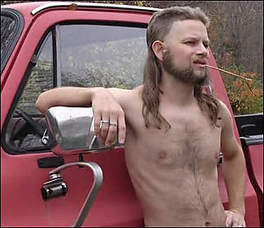
Muley
Examples of stereotypical behavior:
“‘You ain’t tellin’ me how to skin my life, by any chancet?’ Joad grinned ‘No I ain't. If you wanta drive your head into a pile a broken glass, there ain’t nobody can tell you different.’” (47)
“The preacher stirred nervously. ‘You should of went too. You shouldn’t of broken up the fambly’ ‘I couldn’t,’ said Muley Graves. ‘Somepin jus’ wouldn’ let me.’” (48)
“‘No. No, I won’t. I can’t go away. I got to stay now. Time back I might of went. But now. Fella gits to thinkin’, an’ he gits to knowin’. I ain’t never goin’.’” (110)
Purpose of Including Muley:
In chapter 6 muley is introduced as a stereotypical character. Muley is depicted as a prideful yet homeless, old-fashioned redneck, who is too stubborn to adapt to the new ways like everyone else. He wants to stay old-fashioned and in his home, the country. He is too scared to make the journey to the West. Steinbeck entered Muley into “the game” to provide readers with background knowledge of the refusal and denial that many people went through when they were forced out of their homes.

Slide 5
Conclusion
John Steinbeck’s use of character stereotypes is important in the readers understanding of the text. Characters including Ma, Pa, and Muley are completely defined by their stereotype and essential to the story. Ma’s character provides the reader with background knowledge on how important family values and working together were around the time of the dust bowl. Pa began as a stereotypical leader of the household; he was in charge of family responsibilities and “wore the pants” of the family. As the story continued, Pa slowly lost his role as leader to Ma and became just another member of the family. Pa’s character reveals how much roles change in hard times and is essential in understanding how hardship can negatively affect a person. Muley is depicted as a prideful redneck who refuses to leave his land. He also provides the reader with background knowledge on how hard it was for families to leave their homes and the denial and refusal that many people went through.

Slide 6
Citations
Steinbeck, John. The Grapes of Wrath. New York: Penguin Classics, 1992. Print.
"TGOW Character Analysis." SparkNotes. SparkNotes, n.d. Web. 13 Sept. 2014.

